Slide 1
Transmission Media

Slide 2
The transmission medium is the physical path between transmitter and receiver.
In One type of transmission medium , transmission occurs through a solid medium, such as copper twisted pair, copper coaxial cable, and optical fiber
For second type of transmission medium , transmission occurs wireless through the atmosphere, outer space, or water.

Slide 3
Transmission medium and physical layer

Slide 4
Design factors relating to the transmission medium
Bandwidth: the greater the bandwidth of a signal, the higher the data rate that can be achieved.
Transmission impairments: Impairments, such as Attenuation, Noise and Distortion.
Interference: Interference from competing signals in overlapping frequency bands can distort or wipe out a signal.
Number of receivers: A guided medium can be used to construct a point-to-point link or a shared link with multiple attachments.

Slide 5
Classes of transmission media

Slide 6
Electromagnetic spectrum for Transmission Media

Slide 7
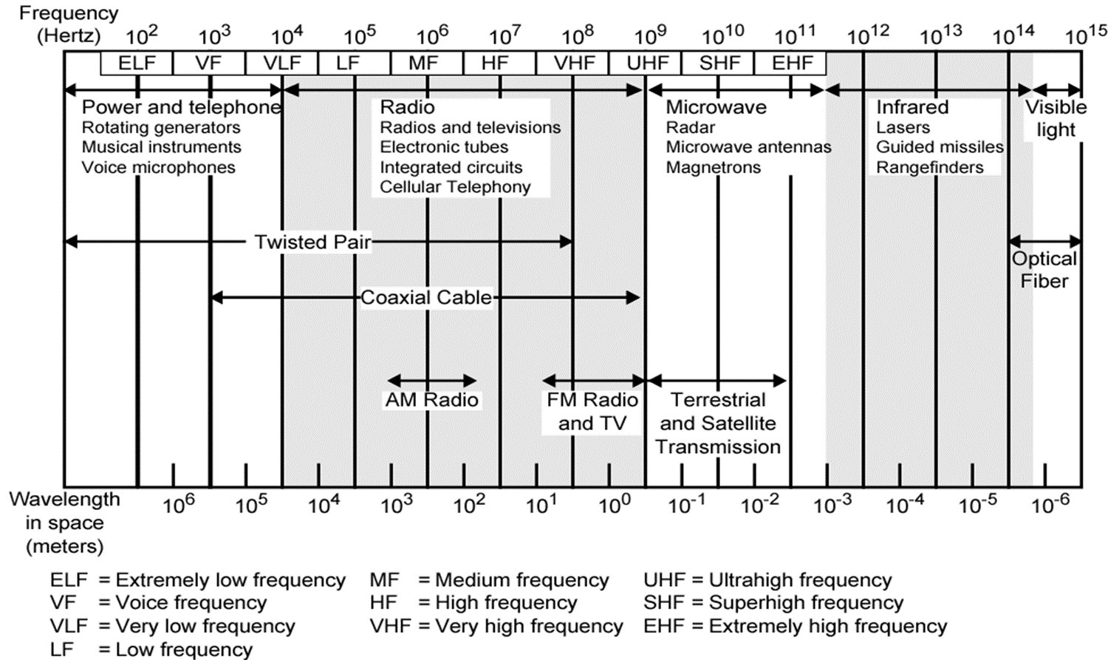
Electromagnetic Spectrum

Slide 8
GUIDED MEDIA
It is a wired or bounded transmission media, transmits data signals through a physical path using cables. The signal is strictly confined and guided along a fixed route.
For Guided Media electromagnetic waves are guided along a solid medium, such as
  Twisted-Pair Cable
  Coaxial Cable
  Fiber-Optic Cable

Slide 9
Twisted Pair
A twisted pair consists of two insulated copper wires, typically about 1 mm thick. The wires are twisted together in a helical form, just like a DNA molecule.
Twisting is done because two parallel wires constitute a fine antenna. When the wires are twisted, the waves from different twists cancel out, so the wire radiates less effectively.
One of the wires is used to carry signals to the receiver, and the other is used only as a ground reference
A signal is usually carried as the difference in voltage between the two wires in the pair. This provides better immunity to external noise because the noise tends to affect both wires the same, leaving the differential unchanged.
Twisting tends to decrease the crosstalk interference between adjacent pairs in a cable.
Neighboring pairs in a bundle typically have different twist lengths to reduce the crosstalk interference

Slide 10
Twisted Pair
UTP and STP cables

Slide 11
Twisted pairs can be used for transmitting either analog or digital information.
The bandwidth depends on the thickness of the wire and the distance travelled, but several megabits/sec can be achieved for a few kilometres in many cases.
Due to their adequate performance and low cost, twisted pairs are widely used

Slide 12
Unshielded Versus Shielded Twisted-Pair Cable
The most common twisted-pair cable used in communications is referred to as unshielded twisted-pair (UTP).
IBM has also produced a version of twisted-pair cable for its use called shielded twisted-pair (STP). STP cable has a metal foil or braided mesh covering that encases each pair of insulated conductors.
Although metal casing improves the quality of cable by preventing the penetration of noise or crosstalk, it is bulkier and more expensive.

Slide 13
Twisted Pair - Transmission Characteristics
Analog
  Amplifiers every 5km to 6km
Digital
  Use either analog or digital signals
  repeater every 2km or 3km
Limited distance
Limited bandwidth (1MHz)
Limited data rate (100MHz)
Susceptible to interference and noise

Slide 14
Near End Crosstalk
Coupling of signal from one pair to another
Coupling takes place when transmit signal entering the link couples back to receiving pair
i.e. near transmitted signal is picked up by near receiving pair

Slide 15
Coaxial Cable
Another common transmission medium is the coaxial cable or‘‘coax’’
It has better shielding and greater bandwidth than unshielded twisted pairs, so it can span longer distances at higher speeds.
Two kinds of coaxial cable are widely used.
One kind, Baseband a 50-ohm cable, is commonly used when it is intended for digital transmission from the start.
The other kind, Broadband a 75-ohm cable, is commonly used for analog transmission and cable television.

Slide 16
A coaxial cable consists of a stiff copper wire as the core, surrounded by an insulating material.
The insulator is encased by a cylindrical conductor, often as a closely woven braided mesh.
The outer conductor is covered in a protective plastic
sheath.
The outer metallic wrapping serves both as a shield against noise and as the second conductor, which completes the circuit.

Slide 17
Coaxial Cable - Transmission Characteristics
Analog
  Amplifiers every few km
  closer spacing required if higher frequencies are used.
  Up to 500MHz
Digital
  Repeater every 1km
  closer spacing needed for higher data rates.

Slide 18
Fiber-Optic Cable
A fiber-optic cable is made of glass or plastic and transmits signals in the form of light.
An optical fiber has an cylindrical shape and consists of 3 concentric section –
(i) Core
(ii) Cladding
(iii) Jacket

Slide 19
Optical fibers use reflection to guide light through a channel.
A glass or plastic core is surrounded by a cladding of less dense glass or plastic.
The difference in density of the two materials must be such that a beam of light moving through the core is reflected off the cladding instead of being refracted into it.

Slide 20
Optical Fiber - Benefits
Greater capacity
  Data rates of hundreds of Gbps
Smaller size & weight
Lower attenuation
Electromagnetic isolation
Greater repeater spacing
  10s of km at least

Slide 21
Propagation Modes
Two modes (multimode and single mode) for propagating light
along optical channels, each requiring fiber with different physical characteristics.

Slide 22
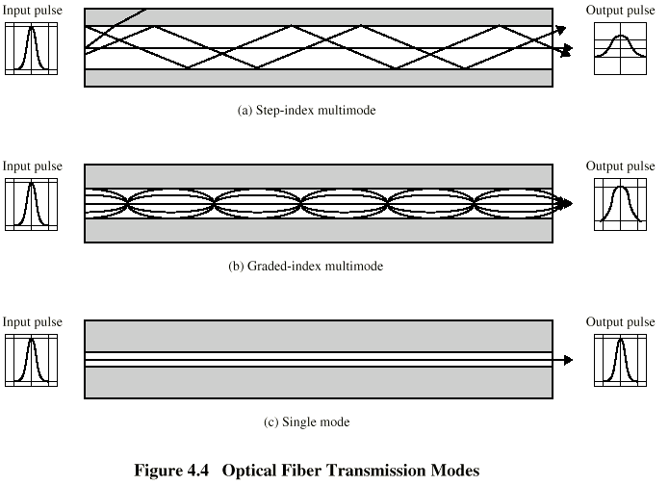

Slide 23
Multimode is so named because multiple beams from a light source move through the core in different paths.
In multimode step-index fiber, the density of the core remains constant from the center to the edges.
A beam of light moves through this constant density in a straight line until it reaches the interface of the core and the cladding.
At the interface, there is an abrupt change due to a lower density; this alters the angle of the beam's motion.
The term step index refers to the suddenness of this change, which contributes to the distortion of the signal as it passes through the fiber.

Slide 24
A second type of fiber, called multimode graded-index fiber, decreases this distortion of the signal through the cable.
The word index here refers to the index of refraction. The index of refraction is related to density.
A graded-index fiber, therefore, is one with varying densities.
Density is highest at the center of the core and decreases gradually to its lowest at the edge.

Slide 25
Single-Mode uses step-index fiber and a highly focused source of light that limits beams to a small range of angles, all close to the horizontal.
The single mode fiber itself is manufactured with a much smaller diameter than that of multimode fiber, and with substantially lower density (index of refraction).
The decrease in density results in a critical angle that is close enough to 90° to make the propagation of beams almost horizontal. In this case, propagation of different beams is almost identical, and delays are negligible.
All the beams arrive at the destination "together" and can be recombined with little distortion to the signal

Slide 26
Optical Fiber - Transmission Characteristics
Act as wave guide for 10¹⁴ to 10¹⁵ Hz
  Portions of infrared and visible spectrum
Light Emitting Diode (LED)
  Cheaper
  Wider operating temp range
  Last longer
Injection Laser Diode (ILD)
  More efficient
  Greater data rate
Wavelength Division Multiplexing

Slide 27
UNGUIDED MEDIA: WIRELESS
Unguided media transport electromagnetic waves without using a physical conductor.
The Signals are transmitted through the air (in some cases water). These are available to anyone who can receive them.
  Radio Waves
  Microwaves
  Infrared

Slide 28
Electromagnetic spectrum for Wireless Transmission
30MHz to 1GHz (Radio Frequency)
  Omnidirectional, Broadcast radio
2GHz to 40GHz (Microwave Frequency)
  Highly directional
  Point to point devices
Microwave communications
  3 x 10¹¹to 2 x 10¹⁴ (Local Frequency)
For Local applications, local point-to-point and multipoint applications within confined areas, such as a single room

Slide 29
Antennas
electrical conductor used to radiate or
collect electromagnetic energy
  1)transmission antenna
  2)reception antenna

Slide 30
Radiation Pattern
Antenna might radiate power in all direction
Not same performance in all directions
How can we determine the performance of an antenna?
Solution is “Radiation Pattern”
Graphical representation of the radiated power
Isotropic antenna is an ideal antenna
Radiates Equal Energy in all directions.
Use as a reference to characterize the power

Slide 31
Antennas Types
1)Omnidirectional Antenna
2)Unidirectional Antenna or Directional Antenna or Parabolic antenna

Slide 32
Isotropic antenna
The radiation pattern of a simple omnidirectional antenna , a vertical half-wave dipole antenna.
In this graph the antenna is at the
center of the "donut," or torus.
Isotropic Radiation Pattern

Slide 33
In a directive antenna, the largest lobe, in the desired direction of
propagation, is called the "main lobe".
The other lobes are called "side lobes" and usually represent radiation in unwanted directions

Slide 34
Antenna Gain - Measure of directionality of antenna
Power output in particular direction compared with that produced by isotropic antenna - Measured in decibels (dB)

Slide 35
Wireless Propagation
Ground Wave
Sky Wave

Slide 36
Line of Sight

Slide 38
Radio Waves
radio is 3kHz to 300GHz
use broadcast radio, 30MHz - 1GHz, for:
  FM radio
  UHF and VHF television
is omnidirectional, Sky wave propagation
They can penetrate through walls but line of sight can give better results.
suffers from multipath interference reflections from land, water, other objects

Slide 39
MICROWAVE
2GHz to 40GHz
Microwaves are used for unicast communication such as cellular telephones, satellite networks, and wireless LANs.
Higher frequency ranges cannot penetrate walls.
TERRESTRIAL MIRCHOWAVE
SATELLITE MICROWAVE

Slide 40
Terrestrial
used for long distance telecommunications and short point-to-point links,
use a parabolic dish to focus a narrow beam onto a receiver antenna

Slide 41
Satellite is relay station
receives on one frequency,
repeats signal and transmits on another
frequency
Separate frequencies are assigned for
upward transmission (uplink)
downward transmission(downlink)
eg. uplink 5.925-6.425 GHz & downlink 3.7-4.2 GHz

Slide 43
Satellite Point to Point Link

Slide 44
Satellite Broadcast Link

Slide 45
Infrared
Infrared communications is achieved using transmitters/receivers (transceivers) that modulate infrared light.
Transceivers must be within the line of sight of each other either directly or via reflection from a light-colored surface such as the ceiling of a room.
infrared does not penetrate walls.

